Slide 1
Digital Portfolio
STUDENT NAME: Priya. S
REGISTER NO AND NMID:
DEPARTMENT: B. Sc. Computer Science
COLLEGE:CSI Ewart Women’s Christian College

Slide 2
PROJECT TITLE
Waste collection portfolio

Slide 3


AGENDA
Problem Statement
Project Overview
End Users
Tools and Technologies
Portfolio design and Layout
Features and Functionality
Results and Screenshots
Conclusion
Github Link
3/21/2024 Annual Review

Slide 4

PROBLEM STATEMENT
Lack of awareness about proper waste disposal.
Increase in plastic, e-waste, and organic waste mismanagement.
Need for an easy-to-understand portfolio showcasing sustainable practices.

Slide 5

PROJECT OVERVIEW
This portfolio highlights waste collection and recycling methods.
Provides a platform to spread awareness about sustainability.
Includes images, features, and contact options for engagement.

Slide 6

WHO ARE THE END USERS?
Students and researchers in Environmental Science.
NGOs and social activists working for waste management.
General public interested in eco-friendly practices.
Community volunteers and local authorities.

Slide 7
TOOLS AND TECHNIQUES
Frontend: HTML, CSS, JavaScript
Design: Responsive layout, Grid system
Icons/Images: Open-source placeholders, eco-themed images
Deployment: GitHub Pages

Slide 8
POTFOLIO DESIGN AND LAYOUT
Header & Navigation: Easy access to sections.
Home Section: Introduction with a welcome note.
About Section: Details about the person/project.
Images Section: Categorized waste collection visuals.
Skills & Hobbies: Represented as badges.
Contact Form: Simple communication form.
8

Slide 9
FEATURES AND FUNCTIONALITY
Sticky navigation bar for smooth browsing.
Grid-based image gallery.
Interactive skills and hobbies section.
Contact form with basic validation and alert system.
Mobile-friendly and responsive design.

Slide 10
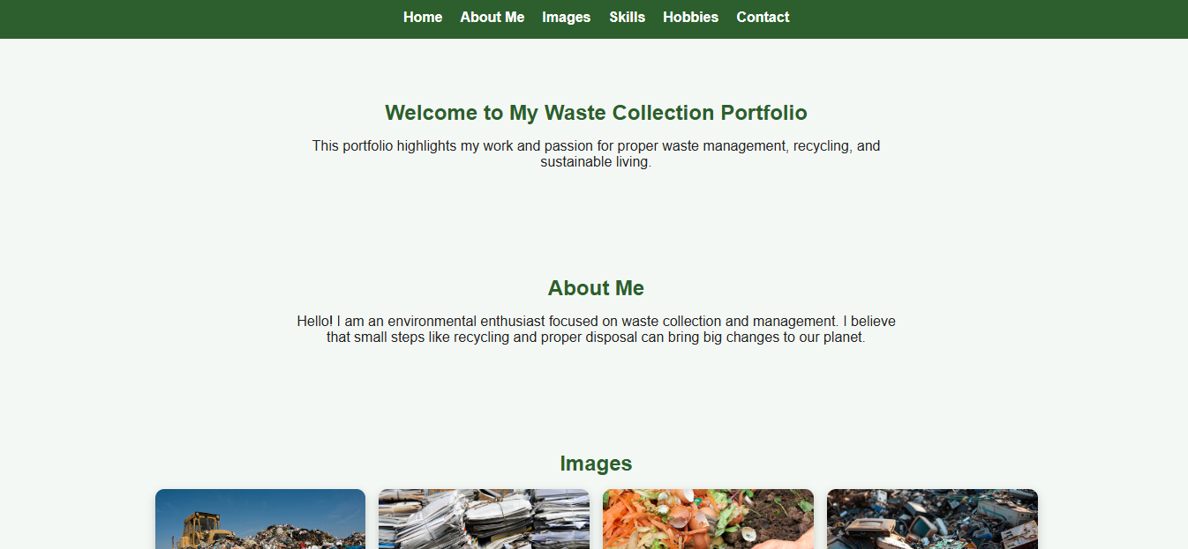
RESULTS AND SCREENSHOTS
3/21/2024 Annual Review
10

Slide 11
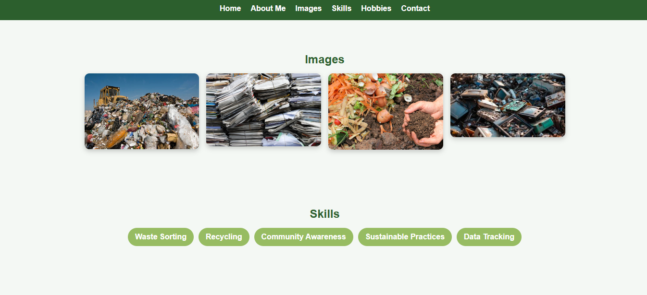

Slide 12
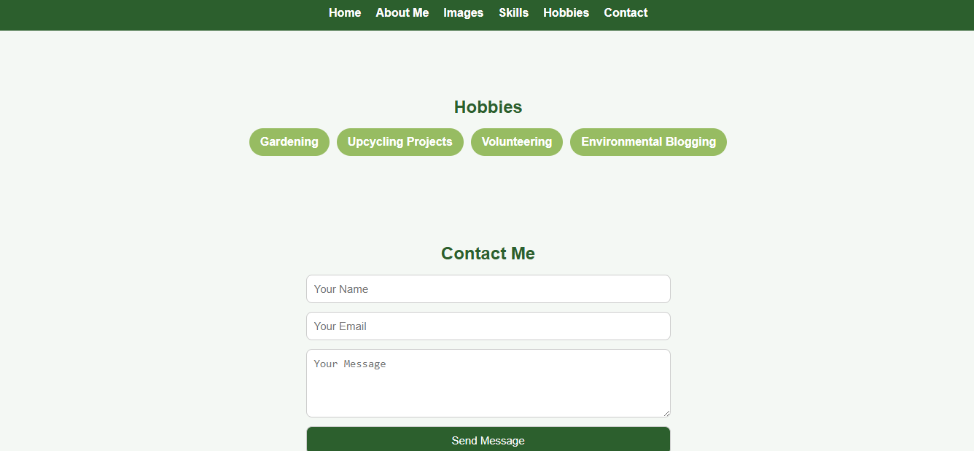

Slide 13
CONCLUSION
A portfolio can be used to spread awareness about waste management.
Demonstrates how technology can support sustainability.
Future scope: Adding database for user messages, advanced analytics, and AI-based waste sorting ideas.
Github link: https://github.com/Spriya2006/waste-collection-
13

